Slide 1
An administrative Journey: Creation of a campus food pantry
Dr. John Cicchetti
Dr. Margaret Olszewska

Slide 2
Learning Outcomes
Identify areas that may present potential challenges in creating or developing a campus food pantry
Explore considerations related to administrative oversight of a campus food pantry
Discover effective ways of securing food supplies and cultivating community partnerships
Identify best practices that contribute to a successful operation of a campus food pantry
Notes:
John

Slide 3
Session overview
National statistics
Patriot Pantry evolution
Decision points along our journey
Summary
Reflective activity
Questions and discussion
Notes:
John

Slide 4
National Statistics
An estimated 20% of college students indicate some level of food insecurity (Dubrick, Matthews, & Cady, 2016)
Approximately 32% of students, who identify as food insecure, believe their education is negatively impacted by their circumstance (Goldrick-Rab, Broton, & Colo, 2016)
A 2018 study estimates that at 4-year colleges and universities, 36% of students were food and housing insecure (Goldrick-Rab, Richardson, Schneider, Hernandez, & Cady, 2018)
Goldrick-Rab et al. (2018) infer that these concerns are even more pronounced for community college students
Notes:
Maggie

Slide 5
Patriot Pantry Evolution
Housing and food insecurity conversations begin in 2012
Fall 2014, the Pop-Up Pantry is organized by a student affairs staff member and his graduate student
A year later, the Pop-Up Pantry is adopted by University Life as a student service
Summer 2016, the Pop-Up Pantry is formally incorporated within the Student Support and Advocacy Center
Spring 2017, the name is changed to the Patriot Pantry
Notes:
Maggie
Patriot Pantry – less confusing, more permanent

Slide 6
Decision Points along our journey
Notes:
Maggie

Slide 7
SPACE
Advocating for permanent space
Initial set up
Shelving
Phone number
E-mail address
Office equipment
Office supplies
Scheduling system
Webpage and other marketing
Notes:
John
Shelving - Parents Fund grant

Slide 8
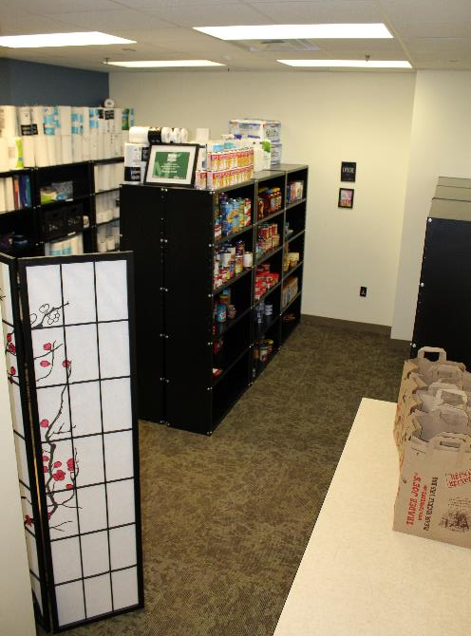

Slide 9
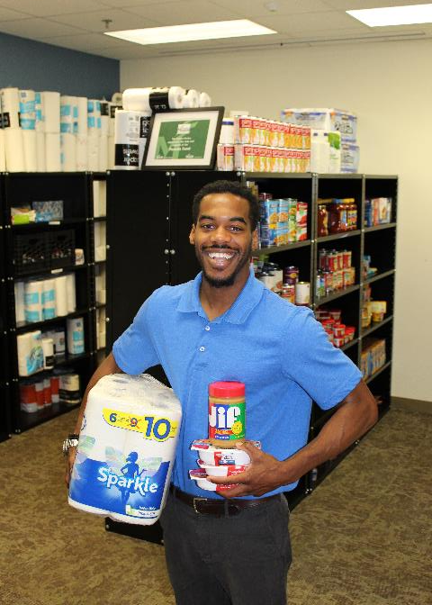

Slide 10
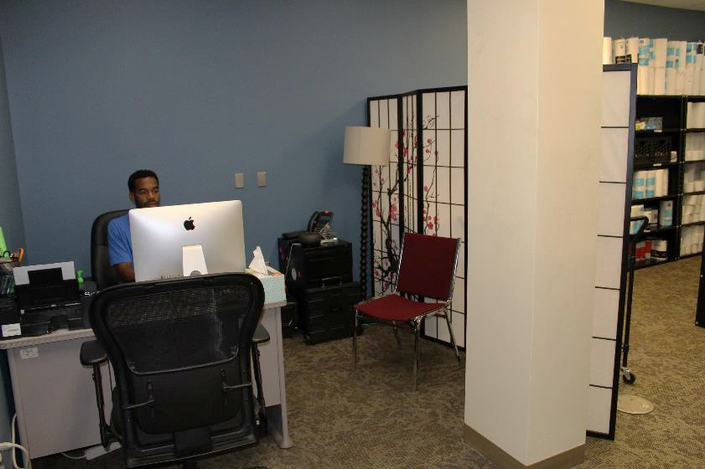

Slide 11
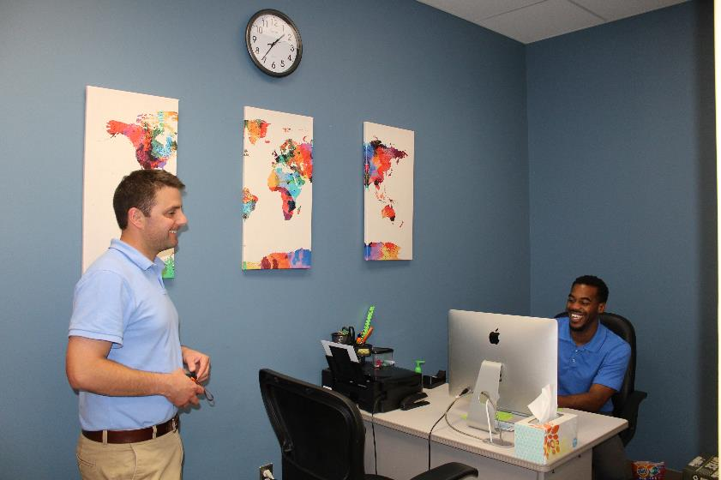

Slide 12
SPACE
Advocating for permanent space
Initial set up
Shelving
Phone number
E-mail address
Office equipment
Office supplies
Scheduling system
Webpage and other marketing
Notes:
John
Shelving - Parents Fund grant

Slide 13
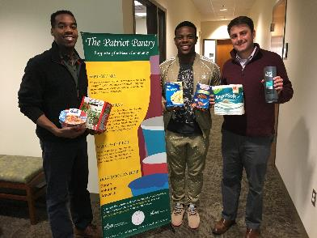
Staffing
Securing funding
Recruiting, training, and supervising student workers, volunteers, and a graduate assistant who are invested
Creating systems for
managing referrals and
record keeping
Developing protocols for
accessing the pantry,
addressing confidentiality, etc.
Notes:
John
Funding- no money > SAIL > centralized funding
Accessing the space- keys, cards, replacement fees

Slide 14
Donations
Accepting non-perishable food, toiletries, and school supplies
Grab-and-go items, self-contained or microwavable
Canned goods - not ideal
Dietary restrictions - vegetarian, vegan, halal, kosher
Managing monetary contributions
Evolution of support from meal vouchers to foundation account
Creation of Amazon account - connecting alumni and supporting affinity for giving
Defining scope of operation – clothing donations outside our focus
Notes:
John

Slide 15
Student initiative to campus Service
Adapting to a new operational paradigm
Balancing student ownership with service limitations
Protecting student privacy – collecting student name and ID while keeping information private
Navigating conflicts of interest – Secret Santa
Notes:
John

Slide 16
Internal Partnerships
Developing a culture of support
Food drive efforts
Parking services
Student Involvement
Creative initiatives – summer stock up challenge
Capitalizing on interest and support
VPSA
Giving Day
Notes:
Maggie

Slide 17
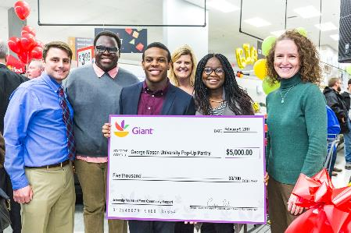
external Partnerships
BB&T Bank support originating from UL Advisory Board
Giant Food grocery store – grand reopening donation and beyond
Religious organizations – monthly donation rotation
Notes:
Maggie

Slide 18
Legal considerations
Food types
Baby food
Perishable items
Student worker use of personal vehicles
Notes:
Maggie

Slide 19
Other considerations
Serving special populations
Marketing and website presence
Defining access to the services
Conducting assessment
Beacon survey – fall semesters 2014-2017
SSAC assessment
Notes:
Maggie
Special populations- international students, educating on actual need
Access- enrolled students
SSAC assessment – feedback on user experience

Slide 20
Summary
Space
Staffing
Donations
Service
Internal/External Partnerships
Legal Considerations
Other Considerations
Notes:
Maggie

Slide 21
Reflective activity
Consider the summary points
Space
Staffing
Donations
Service
Internal/External Partnerships
Legal and Other Considerations
Identify opportunities and challenges at your institution
Reflect on how these considerations impact your future endeavors
Notes:
John

Slide 22
“Patriot Pantry helped ease my stress in figuring out how to pay for food and toiletries for a family of three when my mother got sick from cancer. This help allowed me to stay enrolled in school and kept me hopeful. The fact that there are various people donating to this organization and having others coordinate this process is incredibly thoughtful and helpful. Thank you for everything.”
“The Patriot Pantry tremendously helped me with my food insecurity issue. Thanks to your service, I was able to eat sufficient food which helped me be happy, healthy, energized, and most important of all, helped me study well and excel in my classes.”
“The pantry was phenomenal for me! They really understand all of the stressors that college students are under and you can come in without fear of judgement. Such amazing people work there and I'm happy to call them my friends! The Patriot Pantry allowed me have sufficient food and toiletry supplies when I didn't have the money to allocate to those areas while attending Mason. Now I've graduated and have a full-time job where I can afford to provide all of these things, and more, to myself. The impact was so great and appreciated that I will be making donations of my own in the future to help other students that were in my position and beyond.”
Notes:
John

Slide 23
Questions & Discussion

